Slide 1
EEN316 Final Project: Scientific Calculator
Marika Wei, Rich Marino, Brian Hasenstab

Slide 2
Scientific Calculator
Will implement a variety of functions, and allow for storage of multiple numbers.
Could be implemented as IP Core for future use if desirable.

Slide 3
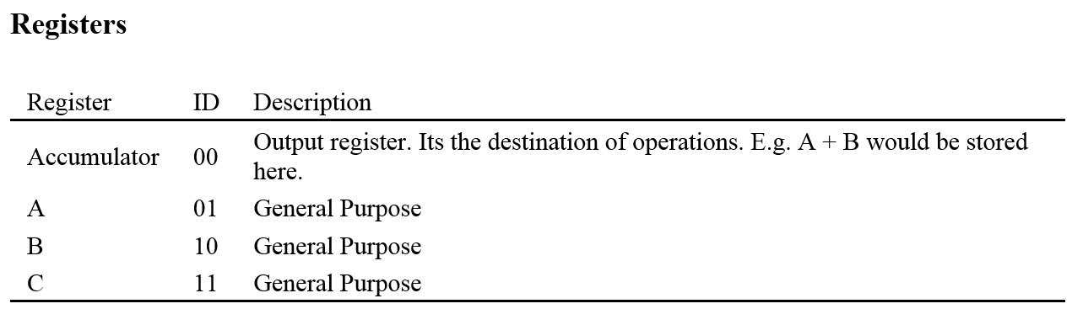
Technical Information - Registers

Slide 4
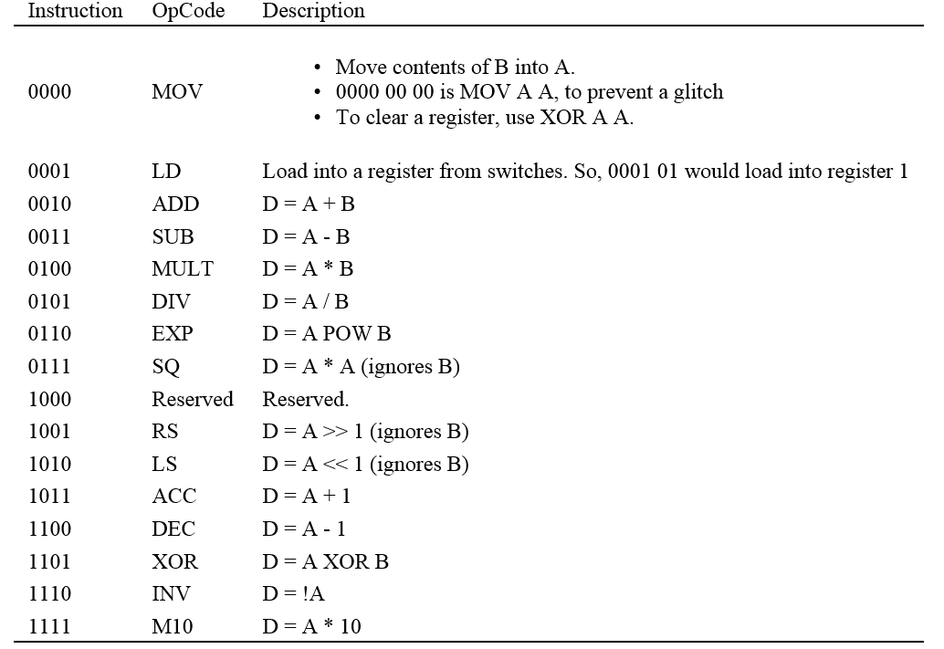
Technical Information - OpCodes

Slide 5
Technical Information – Instruction Format
4-bits
OPCODE
2-bits
A
2-bits
B
4-bits
OPCODE
2-bits
A
8-bits
Input

Slide 6
Technical Information – Input/Output
Input
Left-most 4 switch: opcode
4 more switches: A And B
Right-most 8 switches: Number input
Output
LEDs or 7-segment display ACC register
Possible to display other register with button press

